Slide 1

Money and Tasks Manager Software
Dept. of Computer Science and Engineering
MD. ATIK ID: 222311007 B.Sc. in CSE Varendra University

Slide 2
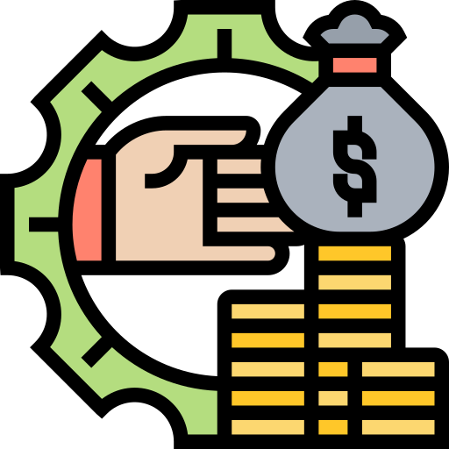
What is money manager software?
Money manager software is a computer program or application that helps individuals or businesses to manage their financial activities such as budgeting, tracking expenses, paying bills, and monitoring investments. It simplifies financial management by providing tools to organize, track, and analyze financial data in one place, making it easier to make informed financial decisions.

Slide 3

Benefits of using a money manager software
Better Financial Organization: Money manager software allows users to keep all their financial information in one place, making it easier to track and manage finances.
Improved Budgeting: Money manager software helps users create and track budgets, allowing them to see where their money is going and make adjustments to reach their financial goals.
Expense Tracking: With money manager software, users can easily track their expenses and see where they are spending their money. This can help identify areas where they can cut back and save money.
Bill Payment: Many money manager software programs include bill payment features, allowing users to pay bills and schedule payments in one place.
Investment Management: Money manager software can also help users track and manage investments, making it easier to monitor performance and make informed investment decisions.

Slide 4
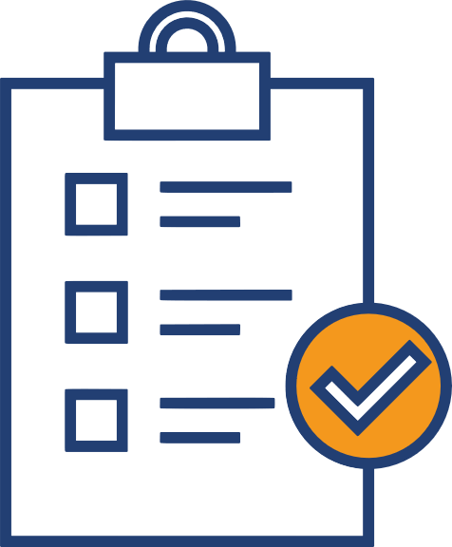
What is tasks manager software?
Task manager software is a computer program or application that helps individuals or teams manage tasks and projects by providing tools to plan, track, and complete tasks efficiently. It simplifies task management by providing a central location for creating, assigning, and tracking tasks, making it easier to collaborate and stay organized.

Slide 5
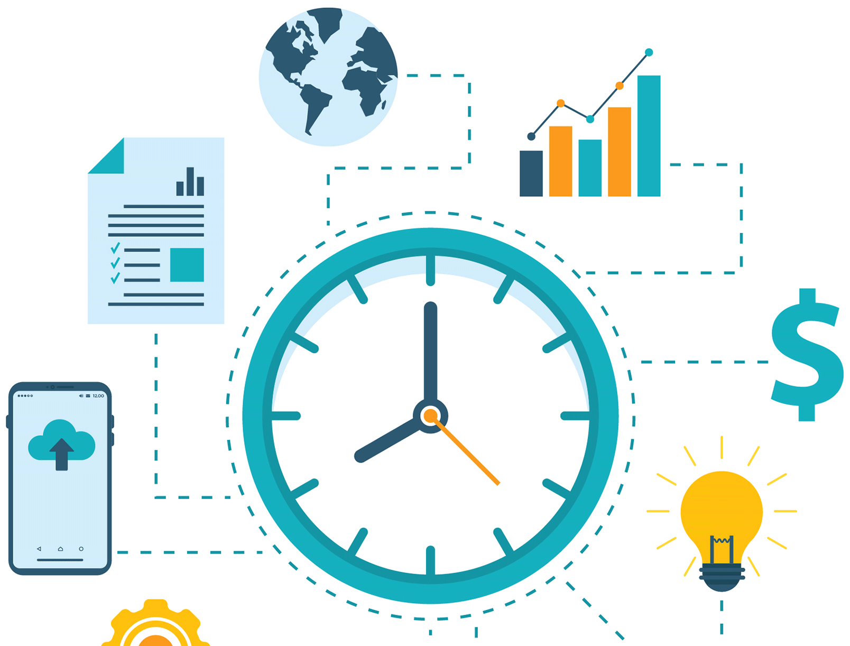
Benefits of using a task manager software
Increased Productivity: Task manager software helps users prioritize tasks, set deadlines, and track progress, leading to increased productivity and efficiency.
Improved Collaboration: Task manager software enables teams to collaborate more effectively by assigning tasks, sharing files and comments, and tracking progress in real-time.
Better Time Management: Task manager software allows users to plan their time effectively by breaking down larger projects into smaller tasks, setting deadlines, and tracking time spent on each task.
Clearer Communication: Task manager software promotes clear communication by providing a central location for task-related information, reducing the risk of miscommunication and misunderstandings.
Enhanced Accountability: Task manager software makes it easier to hold individuals or teams accountable by tracking progress and identifying areas where improvements can be made.

Slide 6
What is money and tasks manager software?
Money and tasks manager software is a computer program or application that combines the functionalities of both money manager and task manager software. It allows users to manage both their financial activities, such as budgeting, expense tracking, and bill payments, as well as their tasks and projects, all in one place.

Slide 7

Why we need to merge money and tasks manager?
Merging money and tasks manager software provides a holistic approach to managing both financial and task-related activities, as they are often interrelated. Combining the functionalities of both software types in a single program can help users better manage their time, prioritize tasks, and make informed financial decisions based on their budget and expenses. It can also improve efficiency, organization, and collaboration for individuals and businesses.

Slide 8
Which features will be available in it?
Budgeting: Users can create and manage budgets to track their income and expenses, and monitor their spending against financial goals.
Expense Tracking: Users can track their expenses and categorize them to better understand where their money is going.
Bill Payment: Users can pay bills and schedule payments directly from the software, eliminating the need to log in to different accounts.
Task Management: Users can create, assign, and track tasks and projects, set deadlines, and prioritize tasks based on importance.
Time Tracking: Users can track their time spent on tasks and projects, helping them identify areas where they can improve productivity.
Reporting: Users can generate reports to view their financial and task-related data in a variety of formats, helping them make informed decisions.
Collaboration: Users can share tasks, projects, and financial information with others, promoting teamwork and better communication.

Slide 9
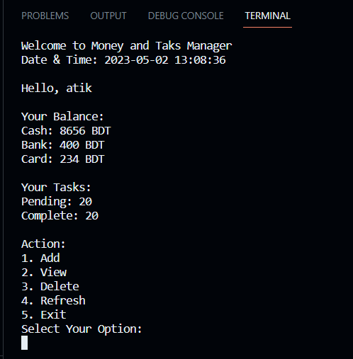

Slide 10
Questions and Answer
Feel free to ask

Slide 11

Thanks for your patience and listening to me.

